Slide 1
mixed effect models Dealing with Autocorrelation
Alejandro Ordonez
Assistant Professor - Department of Bioscience
Section for Ecoinformatics & Biodiversity
Center for Biodiversity Dynamics in a Changing World (BIOCHANGE)

Slide 2
A recap
Mixed-effect models that control for pseudo replication can be build by allowing
Intercepts to vary – Random intercept model
Intercepts and the slopes to vary - Random slope-intercept
lme(Y~Fix.Eff,random=~1+Fix.Eff|Rand.Eff,data=data.In)
Dealing with heterogeneous variances requires modelling the variance using multiple strategies.
Model selection in mixed and variance models is a two step process:
Part one – define the best random and/or variance structure
Part two – define the best fixed effect structure

Slide 3
mixed effect models What we will talk about today
Pseudo-replication in space – Solving non independence
Measuring Auto correlation
Spatial – The main topic of the course
Modelling correlation structures – Distance decay function of correlations.
Spatial Autoregressive Models– Spatial connections between observations define the correlations.

Slide 4
So far so good?
Any questions?
Ready to start?

Slide 5
Mixed Effects Models the problem of independence
Observational/experiments can have:
A nested observational/experimental → samples taken across different spatial-temporal-taxonomic scales
Spatial-Temporal-Evolutionary proximity removes independence between samples → Autocorrelation
What does this mean?
Samples are not independent

Slide 6
Autocorrelation: another form of non-independence
Can we say that we have independent data
if we sample across time/space/species?
Sampled objects will show a level of correlation, so that the values of the same variables will be related among objects
NOT Always
why?

Slide 7
Autocorrelation: another form of non-independence
Time
Space
Species
What is this non–independence affecting?

Slide 8
Spatial autocorrelation
The spatial autocorrelation concept is an extension of temporal autocorrelation concept.
But a bit more complicated as…
Time is one-dimensional [Only goes in one direction → forward]
By comparison, spatial objects have
Two dimensions (for the most part - 3 if you consider elevation!)
Complex shapes
This raises a problem: how to determine what is “near”?

Slide 9
Spatial autocorrelation
Measuring spatial autocorrelation involves describing the degree two which observations (values) at spatial locations, are similar to each other.
So we need two things:
Observations ➔ The variable that is measured
Locations ➔ The coordinates of where this was measured
high
Locations
Latitude (y)
Observations
low
Long (x)

Slide 10
Spatial autocorrelation
A commonly used statistic that describes spatial autocorrelation is Moran’s I
It evaluates whether the pattern expressed is clustered, dispersed, or random.
Other indices include
Geary’s-C
The join-count index [for binary data].
The semi-variogram ➔ commonly used for interpolation approaches [krigging]

Slide 11
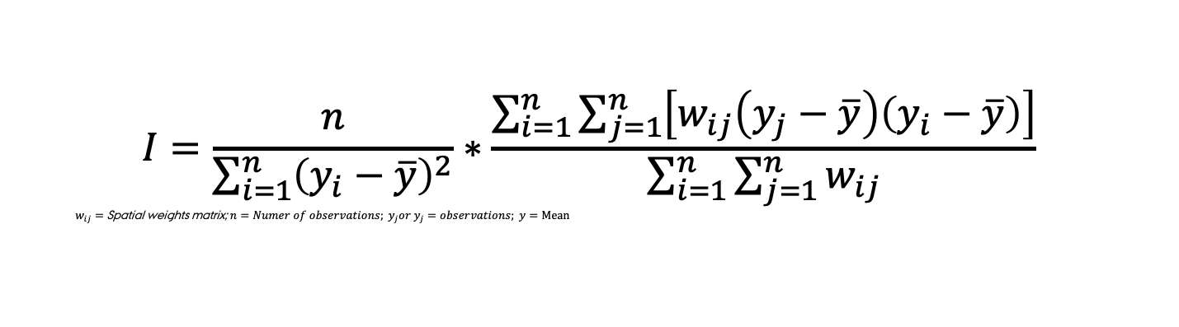
Spatial autocorrelation Moran’s I
The general idea:
Spatial autocorrelation is characterized by a correlation in a signal among nearby locations in space
Values range between −1 to +1 and usually transformed to z-scores (μ = 0,σ² = 1)
The math:
Look familiar? : This is an expanded version of the formula to compute the correlation coefficient
Patrick Alfred Pierce Moran
$$I=\frac{n}{\sum_{i=1}^{n}{{\left(y_{i}−\overline{y}\right)}^{2}}}∗\frac{\sum_{i=1}^{n}{\sum_{j=1}^{n}{\left[w_{ij}\left(y_{j}−\overline{y}\right)\left(y_{i}−\overline{y}\right)\right]}}}{\sum_{i=1}^{n}{\sum_{j=1}^{n}{w_{ij}}}}$$
$w_{ij}=$ Spatial weights matrix; $n=Numer of observations; y_{j}or y_{j}=observations; \overline{y}=Mean$

Slide 12
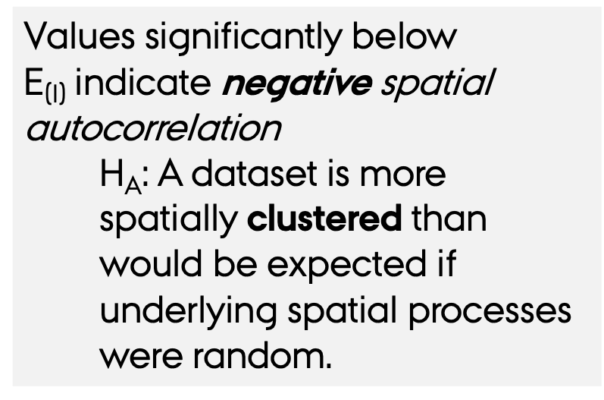
Spatial autocorrelation Moran’s I
Testing for significance:
We compare it the expected (normal) value E_{(I)}
Values significantly below E_{(I)} indicate negative spatial autocorrelation
H_{A}: A dataset is more spatially clustered than would be expected if underlying spatial processes were random.
Values significantly above E_{(I)} indicate positive spatial autocorrelation.
H_{A}: A dataset is more spatially dispersed than would be expected if underlying spatial processes were random.

Slide 13
Spatial autocorrelation Moran’s I
Percentage with blood group A in Eire show a significant spatial structure?
The Eire data set – (part of the spdep package)
require(spdep); require(maptools); require(rgdal)
eire <- readOGR(system.file("shapes/eire.shp", package="spData")[1])
brks <- round(fivenum(eire$A), digits=2)
cols <- rev(heat.colors(4))
plot(eire,
col=cols[findInterval(eire$A,
brks,
all.inside=TRUE)],
main="Percentage with blood group A in Eire")
legend(x=c(-50, 70),
y=c(6120, 6050),
leglabs(brks),
fill=cols,
bty="n")

Slide 14
Spatial autocorrelation Moran’s I
The mechanics in R – the fast way
y <- eire$A # data in Percentage with blood group A in Eire
# Estimate the distance weight matrix to reflect the intensity of the geographic relationship between observations
w <- poly2nb(eire, row.names=rownames(eire@data)) # nb2listw is a method from the spdep package that creates spatial weights list based on neighbors. style='B' is for binary coding, that is only adjacent polygons are considered
ww <- nb2listw(w, style=‘B’)
moran(y, ww, n=length(ww$neighbours), S0=Szero(ww))
# moran is a method form the spdep package. Where Szero(ww) is the sum of all those pairs where the weights are set to zero
$I[1] 0.4794476
$K[1] 2.977336
Moran’s I

Slide 15
Spatial autocorrelation Moran’s I
The mechanics in R – the fast way
# Test for significance
moran.test(y, ww, randomisation=FALSE) # variance of I calculated using a normal approximation
Moran I test under normality
data: y
weights: ww
Moran I statistic standard deviate = 4.4488, p-value = 4.3e-06
alternative hypothesis: greater
sample estimates:
Moran I statistic Expectation Variance
0.47944757 -0.04000000 0.013632950
Positive Values mean a clustered structure
Significant values mean that the data is spatially structured

Slide 16
Spatial autocorrelation Moran’s I
The mechanics in R – the fast way
# Test for significance
moran.test(y, ww, randomisation=TRUE) # variance of I calculated under the assumption of randomisation
Moran I test under randomisation
data: y
weights: ww
Moran I statistic standard deviate = 4.4488, p-value = 4.32e-06
alternative hypothesis: greater
sample estimates:
Moran I statistic Expectation Variance
0.47944757 -0.04000000 0.01363295
Positive Values mean a clustered structure
Significant values mean that the data is spatially structured

Slide 17
Spatial autocorrelation Moran’s I
The mechanics in R – the fast way
# Test for significance
moran.mc(y, listw= ww, nsim=1000) # Significance Based on random permutations of x for the given spatial weighting scheme
Monte-Carlo simulation of Moran I
data: y
weights: ww
number of simulations + 1: 1001
statistic = 0.47945, observed rank = 1001, p-value = 0.000999
alternative hypothesis: greater
The hypothesis test define if the distribution is clustered
Significant values mean that the data is spatially structured

Slide 18
So far so good?
Any questions?
Ready to move on?

Slide 19
Spatial autocorrelation in statistical modeling
Making inference with spatial data might be problematic:
Nearby things are similar, and it may not be fair to consider individual cases as independent.
They may be pseudo-replicates.
How to know if we have an autocorrelation problem?
Evaluate the for spatial autocorrelation in the residuals:
These should NOT BE AUTOCORRELATED!

Slide 20
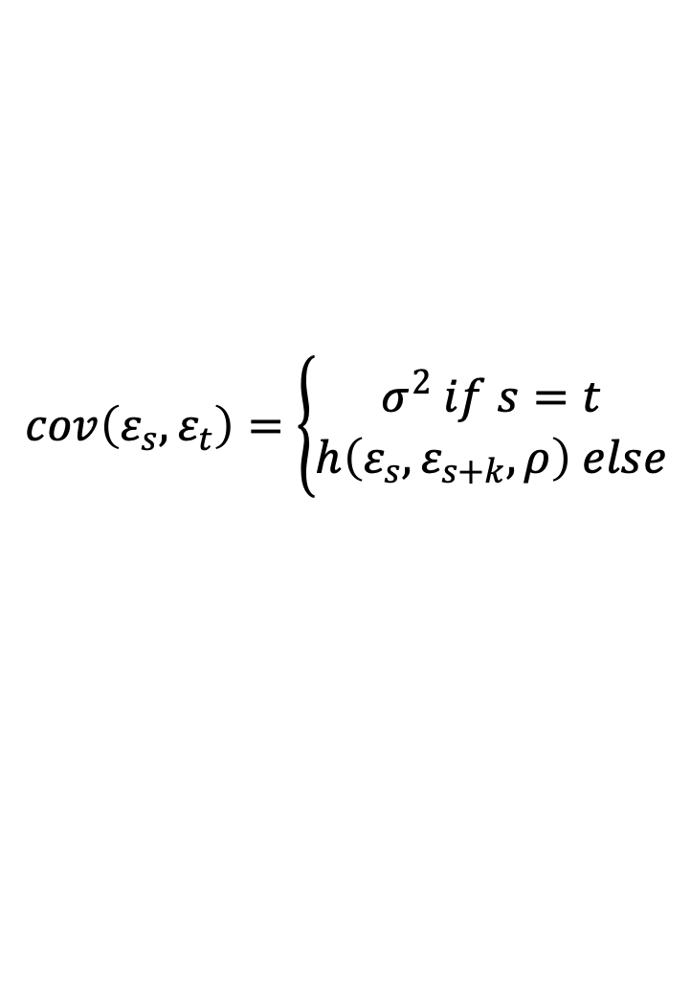
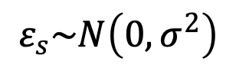
Spatial autocorrelation The math behind the model
$$ε_{s}\sim N\left(0,σ^{2}\right)$$
$$cov\left(ε_{s},ε_{t}\right)=\left\{\begin{aligned}σ^{2} if s=t \\ h\left(ε_{s},ε_{s+k},ρ\right) else\end{aligned}\right.$$
Correlation function
function that measures the spatial dependence between two sites
We assume stationarity
Correlation between the residuals ε_{s} and ε_{t} only depends on their time difference (s – t)
The goal
Find the best optimal parameterisation of the correlation function

Slide 21
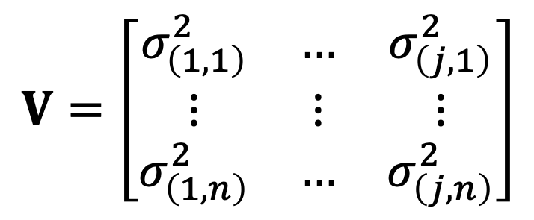
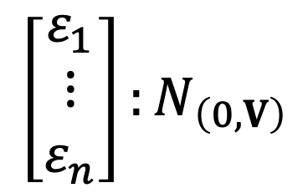
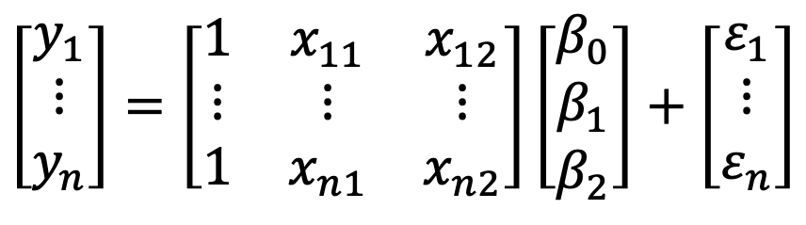
Spatial autocorrelation The math behind the model
Random part
$$\left[\begin{matrix}y_{1} \\ ⋮ \\ y_{n}\end{matrix}\right]=\left[\begin{matrix}1 & x_{11} & x_{12} \\ ⋮ & ⋮ & ⋮ \\ 1 & x_{n1} & x_{n2}\end{matrix}\right]\left[\begin{matrix}β_{0} \\ β_{1} \\ β_{2}\end{matrix}\right]+\left[\begin{matrix}ε_{1} \\ ⋮ \\ ε_{n}\end{matrix}\right]$$
Observations are not independent
Normally distributed errors
Variance heterogeneity
$$V=\left[\begin{matrix}σ_{\left(1,1\right)}^{2} & … & σ_{\left(j,1\right)}^{2} \\ ⋮ & ⋮ & ⋮ \\ σ_{\left(1,n\right)}^{2} & … & σ_{\left(j,n\right)}^{2}\end{matrix}\right]$$
$$\left[\begin{matrix}ε_{1} \\ ⋮ \\ ε_{n}\end{matrix}\right]:N_{\left(0,V\right)}$$
Variances are not equal across observations

Slide 22
Spatial autocorrelation Fitting correlation functions
Exponential correlation
corExp
Spherical correlation
corSpher
Linear correlation
corLin
Gaussian correlation
corGaus
Rational quadratic correlation
corRatio

Slide 23
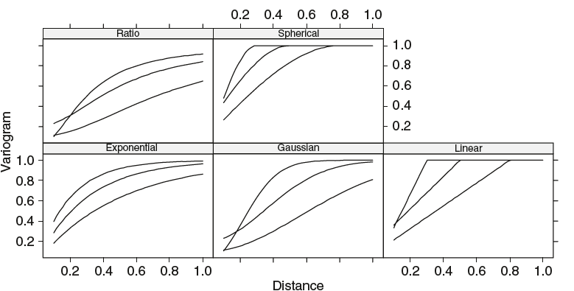
Spatial autocorrelation Fitting correlation functions
Variograms are measures the spatial dependence between two sites

Slide 24
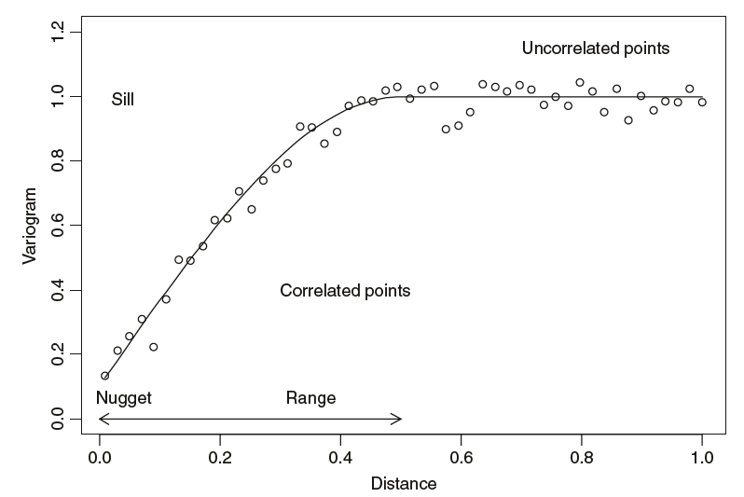
Spatial autocorrelation Fitting correlation functions
sill ➔ the asymptotic value
nugget ➔ the y-value when the distance is 0.
range ➔ the distance where the sill occurs

Slide 25
Spatial autocorrelation R – implementation
require(nlme)
eire.Dat <- data.frame(eire@data[,c("A","towns")],
x=coordinates(eire)[,1],
y=coordinates(eire)[,2])
B1A<- gls(A ~ towns, data= eire.Dat,
correlation=corSpher(form=~x + y, nugget=TRUE))
B1B<- gls(A ~ towns, data= eire.Dat,
correlation=corLin(form=~x + y, nugget=TRUE))
B1C <- gls(A ~ towns, data= eire.Dat,
correlation=corRatio(form=~x + y, nugget=TRUE))
B1D <- gls(A ~ towns, data= eire.Dat,
correlation=corGaus(form=~x + y, nugget=TRUE))
B1E <- gls(A ~ towns, data= eire.Dat,
correlation=corExp(form=~x + y, nugget=TRUE))
Adding the correlation structure to the model
How would you define the best correlation structure?

Slide 26
So far so good?
Any questions?
Ready to move on?

Slide 27
Zuur et al. (2007 - Analysing Ecological Data) they explored the influence of relief, soil, and climatic factors on the forests of the Raifa section of Volzhsko-Kamsky State Nature Biosphere.
Here we will focus on three variables:
Response
Boreality index (no of boreal species/site richness; nBor).
Predictors - remotely sensed variables derived from the LANDSAT 5 satellite images
Normalised difference vegetation index (NDVI).
Temperature (T61).
Index of wetness (Wet)
Index of greenness (Grn).
For simplicity I will only focus on wetness as a predictor
QUESTION TO ANSWER
How environmental conditions determine “Boreality”

Slide 28
The procedure
Applying a model without a Spatial Correlation Structure.
Use graphical tools to asses violation of independence.
Statistically evaluate the violation of independence.
Add the defined Spatial Correlation Structure to the regression.
Select the best set of predictors.

Slide 29
Step 1 Build a run of the mill LM
> B.lm<-lm(nBor~Wet,data=Boreality)
> summary(B.lm)
Call:
lm(formula = nBor ~ Wet, data = Boreality)
Residuals:
Min 1Q Median 3Q Max
-4.504 -1.441 -0.265 1.300 7.545
Coefficients:
Estimate Std. Error t value Pr(>|t|)
(Intercept) 5.9802 0.2153 27.78 <2e-16 ***
Wet 88.7367 6.0244 14.73 <2e-16 ***
---
Signif. codes: 0 ‘***’ 0.001 ‘**’ 0.01 ‘*’ 0.05 ‘.’ 0.1 ‘ ’ 1
Residual standard error: 1.984 on 531 degrees of freedom
Multiple R-squared: 0.2901, Adjusted R-squared: 0.2887
F-statistic: 217 on 1 and 531 DF, p-value: < 2.2e-16
But can we trust these estimates?
There is significant effect and positive of Wetness on Boreality

Slide 30
Step 2 Asses the Spatial Autocorrelation
This graph shows a spatial pattern (e.g. groups of negative or positive residuals are close to each other).
This means that there may be a missing covariate or spatial correlation.
E <- residuals(B.lm,normalized=T)
library(gstat)
require(sp)
mydata<-data.frame(E,Boreality$x,Boreality$y)
coordinates(mydata)<-~ Boreality.x + Boreality.y
bubble(mydata,"E",col=c("black","grey"),
main="Residuals",xlab="X-coordinates",
ylab="Y-coordinates")
Why we are plotting the residuals and not Borelaity?

Slide 31
Step 2 Asses the Spatial Autocorrelation
The semi-variogram shows the level of covariance as a function of distance
small values high correlation
Note that there is a clear spatial correlation up to about 1000 m.
This semi-variogram assumes isotropy…
What is this?
E <- residuals(B.lm,normalized=T)
Vario1 = variogram(E ~ 1, mydata)
plot(Vario1$gamma~Vario1$dist,
xlab="Distance",ylab="Variogram")
lines(loess(Vario1$gamma~Vario1$dist))

Slide 32
E <- residuals(B.lm,normalized=T)
Vario2 <- variogram(E ~ 1, mydata,
alpha = c(0, 45, 90,135))
plot(Vario2)
Isotropic means that variability is the same in all directions
Anisotropic means that variability changes with directions
The alpha parameter defines the major range direction

Slide 33
Step 3 Asses the Autocorrelation
Moran I test
at different at different lag-distances
As for the semi-variogram we see a significant correlation at lag distances below 1000m
Why we are plotting the residuals and not Borelaity?
require(ncf)
E <- residuals(B.lm,normalized=T)
Splcor.LC4 <- spline.correlog(x=Boreality$x,
y=Boreality$y,
z=E,
latlon = F,
resamp=100)
plot(Splcor.LC4)

Slide 34
Step – 4 Add the Spatial Structure to the model
All set of models are fitted specifying alternative specifications of the spatial correlation structure and one with out it
f1 <- formula(Bor ~ Wet)
B1.gls<-gls(f1, data = Boreality)
B1A<-gls(f1,
correlation=corSpher(form=~x+y,nugget=T),data=Boreality)
B1B<-gls(f1,
correlation=corLin(form=~x+y,nugget=T),data=Boreality)
B1C<-gls(f1,
correlation=corRatio(form=~x+y,nugget=T),data=Boreality)
B1D<-gls(f1,
correlation=corGaus(form=~x+y,nugget=T),data=Boreality)
B1E<-gls(f1,
correlation=corExp(form=~x+y,nugget=T),data=Boreality)

Slide 35
Step - 4 Select the best Spatial Structure
> anova(B1.gls,B1A)
Model df AIC BIC logLik Test L.Ratio p-value
B1.gls 1 3 2244.558 2257.383 -1119.279
B1A 2 5 2248.558 2269.932 -1119.279 1 vs 2 4.893e-07 1
> anova(B1.gls,B1C)
Model df AIC BIC logLik Test L.Ratio p-value
B1.gls 1 3 2244.558 2257.383 -1119.279
B1C 2 5 2123.111 2144.485 -1056.556 1 vs 2 125.4471 <.0001
> anova(B1.gls,B1D)
Model df AIC BIC logLik Test L.Ratio p-value
B1.gls 1 3 2244.558 2257.383 -1119.279
B1D 2 5 2127.798 2149.172 -1058.899 1 vs 2 120.7604 <.0001
> anova(B1.gls,B1E)
Model df AIC BIC logLik Test L.Ratio p-value
B1.gls 1 3 2244.558 2257.383 -1119.279
B1E 2 5 2119.263 2140.637 -1054.631 1 vs 2 129.2955 <.0001
Does adding any spatial structure makes the model better than not having it?

Slide 36
Step - 4 Select the best Spatial Structure
How to select the best Spatial Structure?
Use an AIC criteria
> AIC(B1.gls,B1A,B1B,B1C,B1D,B1E)
df AIC
B1.gls 3 2244.558
B1A 5 2248.558
B1B 5 2248.558
B1C 5 2123.111
B1D 5 2127.798
B1E 5 2119.263
No Cor
corSpher
corLin
corRatio
corGaus
corExp
Why not use a Log-likelihood ratio test?

Slide 37
What is the end result of all this effort?
No spatial structure in the residuals!!!
Vario2E <- Variogram(B1E, form =~ x + y,
robust = TRUE,
maxDist = 2000,
resType = "normalized")
plot(Vario2E $variog ~ Vario2E $dist,
xlab="Distance",ylab="Variogram",
ylim=c(0,1))
lines(loess(Vario2E$variog ~ Vario2E $dist))

Slide 38
So far so good?
Any questions?
Ready to move on?

Slide 39
Spatial autocorrelation in statistical modeling
Spatial autocorrelation of residuals may mean the model is misspecified.
Add (or perhaps remove) variables
Formulate a model to control for spatial autocorrelation
Simultaneous autoregressive models (SAR)
Spatial eigenfunctions
Response at each location is a function of the explanatory variable AND values of the response at neighbouring locations
Eigenvectors of spatial configuration matrices are computed and used as predictors in linear models

Slide 40
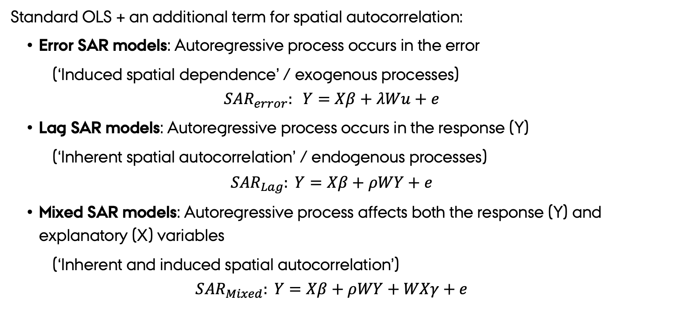
Simultaneous autoregressive models (SAR)
Standard OLS + an additional term for spatial autocorrelation:
Error SAR models: Autoregressive process occurs in the error
(‘Induced spatial dependence’ / exogenous processes)
$${SAR}_{error}: Y=Xβ+λWu+e$$
Lag SAR models: Autoregressive process occurs in the response (Y)
(‘Inherent spatial autocorrelation’ / endogenous processes)
$${SAR}_{Lag}: Y=Xβ+ρWY+e$$
Mixed SAR models: Autoregressive process affects both the response (Y) and explanatory (X) variables
(‘Inherent and induced spatial autocorrelation’)
$${SAR}_{Mixed}: Y=Xβ+ρWY+WXγ+e$$

Slide 41
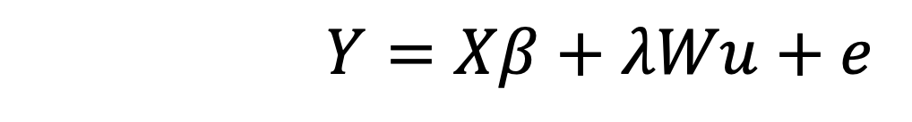
Simultaneous autoregressive error models (SAR_{error})
Provide good estimates and are recommended when dealing with spatially autocorrelated data (Kissling & Carl 2007)
Spatially dependent error term
Spatial structure
$$Y=Xβ+λWu+e$$
Error
Predictors and regression coefficients
Defining the spatial weights matrix, W, is crucial

Slide 42
Finding neighborhoods in R (1st step to a spatial weights matrix)
Two ways to specify neighbours of each observation:
Distance based → spdep::dnearneigh()
Coordinates (matrix or SpatialPoints)
dnearneigh(x, d1, d2, row.names = NULL, longlat = NULL)
Minimum and maximum distances
(in km if longlat = T)
Returns a list of vectors giving the neighbors for each point

Slide 43
Finding neighborhoods in R (1st step to a spatial weights matrix)
Two ways to specify neighbours of each observation:
Distance based → spdep::dnearneigh()
K nearest neighbors → spdep::knearneigh()
Coordinates (matrix or SpatialPoints)
knn <- knearneigh(x, k=1, longlat = NULL, RANN=TRUE)
knn2nb(knn)
number of nearest neighbors to be returned
Returns a list of vectors giving the neighbors for each point

Slide 44
Finding neighborhoods in R (1st step to a spatial weights matrix)
Distance based
K nearest neighbors
x = c(1,3,2,5)
y = c(3,2,4,4)
#Distance based
n = dnearneigh(cbind(x,y),d1 = 0,d2 = 3)
plot(x,y)
plot(n,cbind(x,y),add=TRUE)
#K nearest neighbors
plot(x,y)
m = knearneigh(cbind(x,y), k=1, longlat = NULL, RANN=TRUE)
plot(knn2nb(m),cbind(x,y), add=TRUE)

Slide 45
Spatial weights matrix neighborhoods to weights
what to do with “neighbor-less” points?
neighbors list
nb2listw(neighbours, style="W", zero.policy=NULL)
Created using
dnearneigh() or knearneigh()
W = row standardized (rows sum to 1)
B = binary (0/1)
C = global standardized (all links sum to n)
U = C/number of neighbors
S = variance stabilization (Tiefelsdorf et al. 1999)

Slide 46
Distance-based neighborhoods
x = runif(100); y = runif(100)
#1. Small distance
n = dnearneigh(cbind(x,y), d1 = 0, d2 = 0.1)
w1 = nb2listw(n,zero.policy = T)
#2. Medium distance
n = dnearneigh(cbind(x,y), d1 = 0, d2 = 0.3)
w2 = nb2listw(n,zero.policy = T)
#3. Large distance
n = dnearneigh(cbind(x,y), d1 = 0, d2 = 0.5)
w3 = nb2listw(n,zero.policy = T)

Slide 47
Distance-based neighborhoods
par(mfrow = c(1,4))
plot(x,y,axes = T,
xlab = "",ylab = "",
main="Raw data",cex.main=4)
plot(x,y,axes = T,
xlab = "",ylab = "",
main ="Small distance",cex.main=4)
plot(w1,cbind(x,y),add=T)
plot(x,y,axes = T,
xlab = "",ylab = "",
main ="Medium distance",cex.main=4)
plot(w2,cbind(x,y),add=T)
plot(x,y,axes = T,
xlab = "",ylab = "",
main ="Large distance",cex.main=4)
plot(w3,cbind(x,y),add=T)

Slide 48
K nearest neighbors
# Slide - K nearest neighbors
x = runif(100); y = runif(100)
#2 neighbours
n = knn2nb(knearneigh(cbind(x,y),k=2,RANN = F))
w4 = nb2listw(n,zero.policy = T)
# 4 neighbors
n = knn2nb(knearneigh(cbind(x,y),k=4,RANN = F))
w5 = nb2listw(n,zero.policy = T)
# 8 neighbors
n = knn2nb(knearneigh(cbind(x,y),k=8,RANN = F))
w6 = nb2listw(n,zero.policy = T)

Slide 49
K nearest neighbors
par(mfrow = c(2,2))
plot(x,y,axes = T,
xlab = "",ylab = "",
main="Raw data",cex.main=3)
plot(x,y,axes = T,
xlab = "",ylab = "",
main="2 Neighbours",cex.main=3)
plot(w4,cbind(x,y),add=T)
plot(x,y,axes = T,
xlab = "",ylab = "",
main="4 Neighbours",cex.main=3)
plot(w5,cbind(x,y),add=T)
plot(x,y,axes = T,
xlab = "",ylab = "",
main="8 Neighbours",cex.main=3)
plot(w6,cbind(x,y),add=T)

Slide 50
Spatial weights matrix neighborhoods to weights
> nb2listw(n,style = "W")$weights
[[1]]
[1] 0.5 0.5
[[2]]
[1] 0.3333333 0.3333333 0.3333333
[[3]]
[1] 0.3333333 0.3333333 0.3333333
[[4]]
[1] 0.5 0.5
> nb2listw(n,style = ”B")$weights
[[1]]
[1] 1 1
[[2]]
[1] 1 1 1
[[3]]
[1] 1 1 1
[[4]]
[1] 1 1
> nb2listw(n,style = ”C")$weights
[[1]]
[1] 0.4 0.4
[[2]]
[1] 0.4 0.4 0.4
[[3]]
[1] 0.4 0.4 0.4
[[4]]
[1] 0.4 0.4>
> nb2listw(n,style = ”S")$weights
[[1]]
[1] 0.4494897 0.4494897
[[2]]
[1] 0.3670068 0.3670068 0.3670068
[[3]]
[1] 0.3670068 0.3670068 0.3670068
[[4]]
[1] 0.4494897 0.4494897

Slide 51
Spatial weights matrix neighborhoods to weights
> nb2listw(n,style = "W")$weights
[[1]]
[1] 0.5 0.5
[[2]]
[1] 0.3333333 0.3333333 0.3333333
[[3]]
[1] 0.3333333 0.3333333 0.3333333
[[4]]
[1] 0.5 0.5
> nb2listw(n,style = ”B")$weights
[[1]]
[1] 1 1
[[2]]
[1] 1 1 1
[[3]]
[1] 1 1 1
[[4]]
[1] 1 1
> nb2listw(n,style = ”C")$weights
[[1]]
[1] 0.4 0.4
[[2]]
[1] 0.4 0.4 0.4
[[3]]
[1] 0.4 0.4 0.4
[[4]]
[1] 0.4 0.4>
> nb2listw(n,style = ”S")$weights
[[1]]
[1] 0.4494897 0.4494897
[[2]]
[1] 0.3670068 0.3670068 0.3670068
[[3]]
[1] 0.3670068 0.3670068 0.3670068
[[4]]
[1] 0.4494897 0.4494897
Emphasizes weakly connected points
Emphasizes strongly connected points
Emphasizes strongly connected points
Tries to balance

Slide 52
Spatial weights matrix neighborhoods to weights
Many options to choose
Define the neighborhood
Define the spatial weights matrix
How to choose?
Think about the question / biology of the system
Try things out! (model selection)
Does it remove residual autocorrelation?!?
Look for stability in model estimates

Slide 53
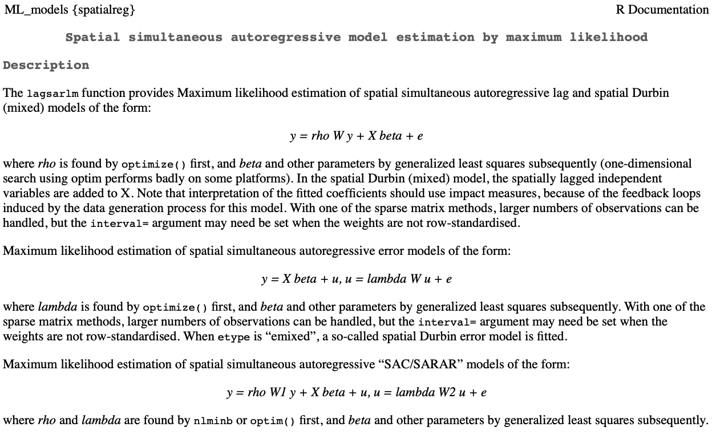
Fitting a SAR_{error} model
spatialreg::errorsarlm()

Slide 54
Fitting a SAR_{error} model
spdep::errorsarlm()
Just like lm()
What to do with neighbor less points?
errorsarlm(formula, listw, zero.policy=NULL)
The neighborhood weights
nb2listw object created using dnearneigh or knearneigh

Slide 55
Fitting a SAR_{error} model
Simulated data from Kissling & Carl (2007 GEB)
Illustrate how to implement a SAR_{error} model
The dataset contains
Information on distribution of a virtual species
Two environmental variables (‘rain’ and ‘jungle’)
Geographic position (‘x’ and ‘y’ coordinates)

Slide 56
Fitting a SAR_{error} model accounting for spatial structure
Estimate the Correlogram
for OLS model residuals
DataSim <- read.csv(”./Appendix_S3_ErrorData.csv")
ols <- lm(organism1 ~ rain + jungle, data=DataSim)
summary(ols)
res.ols <- residuals(ols)
# Correlogram for OLS model residuals
# ‘correlog’ is a function from the ncf package
cor.ols.res <- correlog(x = data$X, y = data$Y,
z=residuals(ols), na.rm=T,
increment=1, resamp=1

Slide 57
Fitting a SAR_{error} model accounting for spatial structure
The OLS models shows spatial autocorrelation in the residuals.
(i.e., Moran I declines as neighbourhood distance increases)
Plot Correlogram
#Plot correlogram
plot(cor.ols.res$correlation[1:20],
type="b", pch=19, cex=1.2, lwd=1.5,
ylim=c(-0.5, 1),
xlab="distance", ylab="Moran's I",
cex.lab=1.5, cex.axis=1.2,cex.main=2,
main="OLS residuals")
abline(h=0)
legend(x=11, y=1,
legend=c("Residuals OLS"),
pch=19, bty="n", cex=1.2)

Slide 58
Fitting a SAR_{error} model Accounting for spatial structure
The OLS models shows spatial autocorrelation in the residuals.
(i.e., Moran I declines as neighbourhood distance increases)
This means that we need to control for the spatial process structuring the residual variation
SAR_{error} model

Slide 59
Fitting a SAR_{error} model The mechanics of the process
The point neighbourhood based on a distance of 1.5
Define the Spatial Weights Matrix
coords <- cbind(DataSim $X, DataSim $Y)
coords <- as.matrix(coords)
#Define neighbourhood (here d2 = 1.5)
nb1.5 <- dnearneigh(coords, 0, 1.5)
#Spatial weights, illustrated with coding style "W" (row standardized)
nb1.5.w <- nb2listw(nb1.5,
glist = NULL,
style = "W",
zero.policy=FALSE)
#Plot the points and spatial neighbourhood
plot(coords)
plot(nb1.5.w, coords,add=T)

Slide 60
Fitting a SAR_{error} model The mechanics of the process
The regression model
can also be a OLS object
sem.nb1.5.w <- errorsarlm(organism1 ~ rain + jungle,
listw = nb1.5.w,
data = DataSim)
The Spatial
Weights Matrix

Slide 61
Fitting a SAR_{error} model Evaluating the model
Evaluate spatial autocorrelation
# Extract residuals of SARerr model
sem.nb1.5.w <- errorsarlm(
organism1 ~ rain + jungle,
listw = nb1.5.w,
data = DataSim)
res.sem <- residuals(sem.nb1.5.w)
# Correlogram
cor.sem <- correlog(x=DataSim$X, y=DataSim$Y,
z= res.sem,
na.rm=T,
increment=1,
resamp=1)
The SAR_{error} model accounted for the residual spatial autocorrelation
(i.e., flat Moran I as distance increases)

Slide 62
So far so good?
Any questions?
Ready to finish?

Slide 63
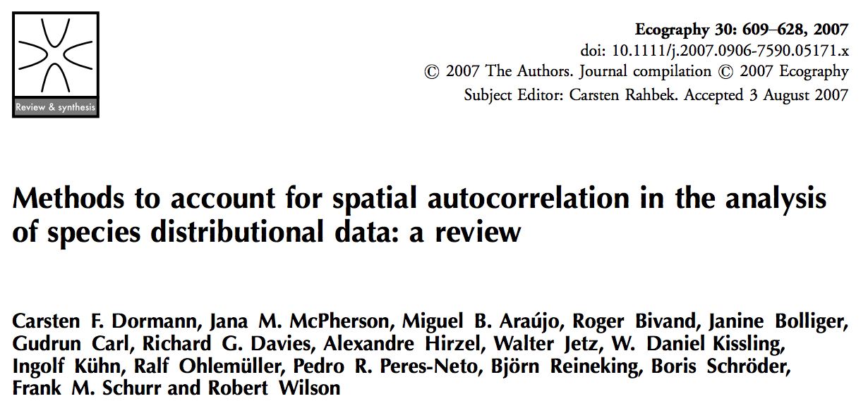
Spatial autocorrelation in statistical modeling

Slide 64
Summary
Spatial autocorrelation is very common in ecology and we often work with data where it cannot be avoided
Often intricately linked to the process of interest!!!
Methods to examine / quantify spatial autocorrelation
e.g., Moran’s I (there are many others)
Spatial pattern in model residuals is problematic
It means there is spatial variation in the data that are unaccounted for.
Models accounting for spatial autocorrelation
Model the correlation structure
SAR (including SAR_{error})
Spatial eigenvectors (or “spatial filters”)
Others… (see e.g., Dormann et al. 2007 Ecography)

Slide 65
So far so good?
Any questions?
Ready to move on?

